Slide 1
CHAPTER # 02: OPERRATING SYSTEM STRUCTURES
BSCS-IV

Slide 2
CONTENTS
Operating-System Services
User and Operating-System Interface
System Calls, System Services
Linkers and Loaders
Why Applications are Operating-System Specific
Operating-System Design and Implementation
Operating-System Structure
Building and Booting an Operating System

Slide 3
01
OPERATIN SYSTEM SERVICES!

Slide 4
OPERATING SYSTEM SERVICES
User Interface
Program Execution
I/O Operations
File System Manipulation
Communication
Error Detection
Resource Allocation
Accounting
Protection and Security

Slide 5
OPERATING SYSTEM SERVICES
SERVICES TO USERS:
1. User interface - Almost all operating systems have a user interface (UI).Varies between Command-Line (CLI) and Graphics User Interface (GUI).
2. Program execution - The system must be able to load a program into memory and to run that program, end execution, either normally or abnormally (indicating error).
3. I/O operations - A running program may require I/O, which may involve a file or an I/O device.

Slide 6
OPERATING SYSTEM SERVICES
4. File-system manipulation - The file system is of particular interest. Programs need to read and write files and directories, create and delete them, search them, list file Information, permission management.
5. Communications – Processes may exchange information, on the same computer or between computers over a network
Communications may be via shared memory or through message passing (packets moved by the OS)

Slide 7
OPERATING SYSTEM SERVICES
6. Error detection – OS needs to be constantly aware of possible errors.
May occur in the CPU and memory hardware, in I/O devices, in user program.
For each type of error, OS should take the appropriate action to ensure correct and consistent computing.
Debugging facilities can greatly enhance the user’s and programmer’s abilities to efficiently use the system.

Slide 8
OPERATING SYSTEM SERVICES
SERVICES TO SYSTEM (Itself)
7. Resource allocation - When multiple users or multiple jobs running concurrently, resources must be allocated to each of them
Many types of resources - CPU cycles, main memory, file storage, I/O devices.
8. Accounting - To keep track of which users use how much and what kinds of computer resources.

Slide 9
OPERATING SYSTEM SERVICES
SERVICES TO SYSTEM (Itself)
9. Protection and security - The owners of information stored in a multiuser or networked computer system may want to control use of that information, concurrent processes should not interfere with each other
Protection involves ensuring that all access to system resources is controlled.
Security of the system from outsiders requires user authentication, extends to defending external I/O devices from invalid access attempts.

Slide 10
02
USER AND OPERATING SYSTEM INTERFACES

Slide 11
COMMAND LINE INTERFACE (CLI)
CLI is a command line program that accepts text input to execute operating system functions.
In the 1960s, using only computer terminals, this was the only way to interact with computers.
In the 1970s an 1980s, command line input was commonly used by Unix systems and PC systems like MS-DOS and Apple DOS.
A command-line interpreter or command-line processor uses a command-line interface to receive commands from a user in the form of lines of text. This provides a means of setting parameters for the environment, invoking executables and providing information to them.

Slide 12
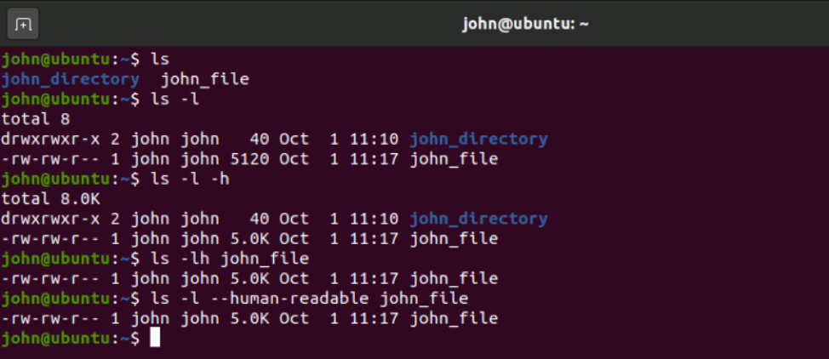
COMMAND LINE INTERFACE (CLI)

Slide 13
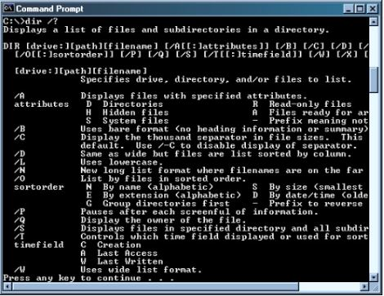
COMMAND LINE INTERFACE (CLI)

Slide 14
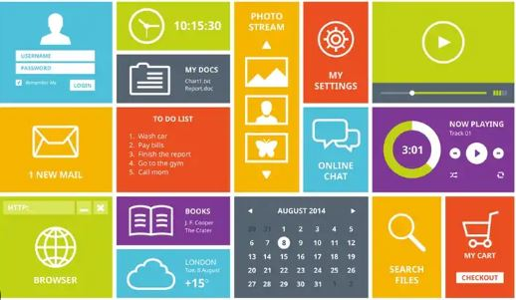
GRAPHICAL USER INTERFACE (GUI)
A graphical user interface (GUI) is an interface through which a user interacts with electronic devices such as computers and smartphones through the use of icons, menus and other visual indicators or representations (graphics).
WIMP
- Windows
- Icons
- Menus
- Pointers

Slide 15
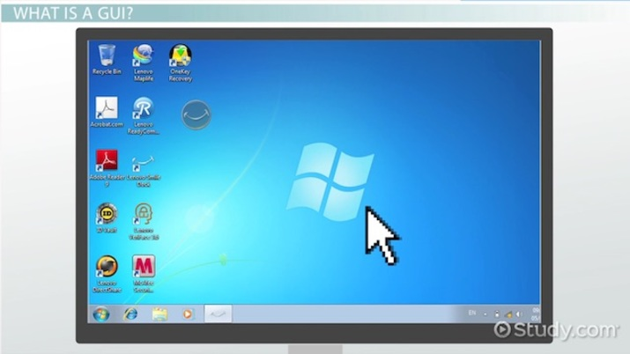
GRAPHICAL USER INTERFACE (GUI)

Slide 16
OTHER INTERFACES
The various types of user interfaces include:
graphical user interface (GUI)
command line interface (CLI)
Menu-driven user interface.
Touch user interface.
Voice user interface (VUI)
Form-based user interface.
Natural language user interface.

Slide 17
03
SYSTEM CALLS, SYSTEM SERVICES

Slide 18
SYSTEM CALLS
A system call is a mechanism that provides the interface between a process and the operating system.
It is a programmatic method in which a computer program requests a service from the kernel of the OS.
System call offers the services of the operating system to the user programs via API (Application Programming Interface).
System calls are the only entry points for the kernel system.

Slide 19
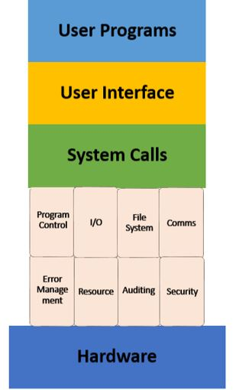
SYSTEM CALLS

Slide 20
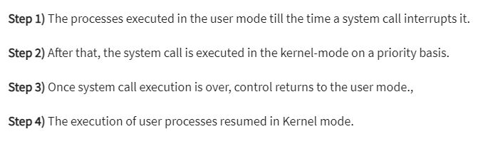
HOW SYSTEM CALLS WORK?

Slide 21
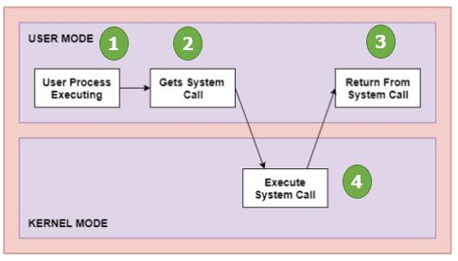
HOW SYSTEM CALLS WORK?

Slide 22
WHY DO YOU NEED SYSTEM CALLS?
Reading and writing from files demand system calls.
If a file system wants to create or delete files, system calls are required.
System calls are used for the creation and management of new processes.
Network connections need system calls for sending and receiving packets.
Access to hardware devices like scanner, printer, need a system call.

Slide 23
TYPES OF SYSTEM CALLS?
Types of System calls
Here are the five types of System Calls in OS:
Process Control
File Management
Device Management
Information Maintenance
Communications

Slide 24
TYPES OF SYSTEM CALLS?
Process Control
These system calls perform the task of process creation, process termination, etc.
Functions:
End and Abort
Load and Execute
Create Process and Terminate Process
Wait and Signal Event
Allocate and free memory

Slide 25
TYPES OF SYSTEM CALLS?
File Management
File management system calls handle file manipulation jobs like creating a file, reading, and writing, etc.
Functions:
Create a file
Delete file
Open and close file
Read, write, and reposition
Get and set file attributes

Slide 26
TYPES OF SYSTEM CALLS?
Device Management
Device management does the job of device manipulation like reading from device buffers, writing into device buffers, etc.
Functions:
Request and release device
Logically attach/ detach devices
Get and Set device attributes

Slide 27
TYPES OF SYSTEM CALLS?
Information Maintenance
It handles information and its transfer between the OS and the user program.
Functions:
Get or set time and date
Get process and device attributes

Slide 28
TYPES OF SYSTEM CALLS?
Communication:
These types of system calls are specially used for interprocess communications.
Functions:
Create, delete communications connections
Send, receive message
Help OS to transfer status information
Attach or detach remote devices

Slide 29
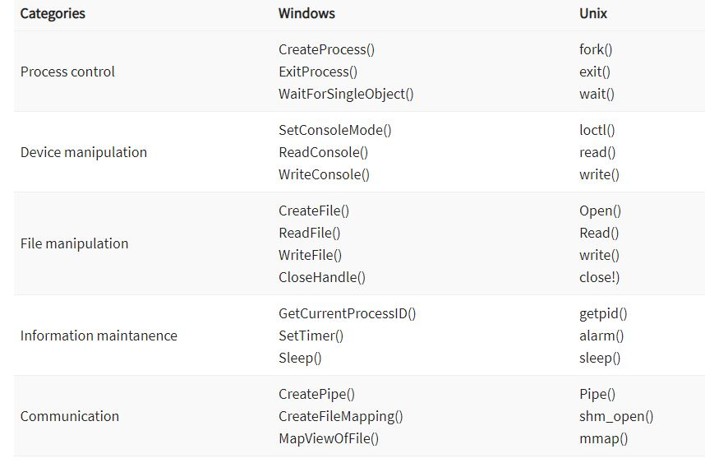

Slide 30
04
OPERATING SYSTEM STRUCTURES

Slide 31
OPERATING SYSTEM STRUCTURES
MONOLITHIC - SIMPLE STRUCTURE
LAYERED STRUCTURE
MICRO KERNEL

Slide 32
SIMPLE STRUCTURE ( MS-DOS )
Such operating systems do not have well defined structure:
- Small
- Simple
- Limited systems.
The interfaces and levels of functionality are not well separated.
MS-DOS is an example of such operating system.
In MS-DOS application programs are able to access the basic I/O routines.
These types of operating system cause the entire system to crash if one of the user programs fails.

Slide 33
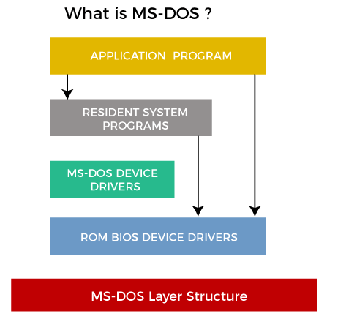
MONOLITHIC-SIMPLE STRUCTURE(MS DOS)
MS-DOS – written to provide the most functionality in the least space
Not divided into modules
Although MS-DOS has some structure, its interfaces and levels of functionality are not well separated

Slide 34
MONOLITHIC - SIMPLE STRUCTURE
ADVANTAGES:
It delivers better application performance because of the few interfaces between the application program and the hardware.
Easy for kernel developers to develop such an operating system.
DISADVANTAGES:
The structure is very complicated as no clear boundaries exists between modules.
It does not enforce data hiding in the operating system.

Slide 35
LAYERED STRUCTURE
An OS can be broken into pieces and retain much more control on system.
In this structure the OS is broken into number of layers (levels).
The bottom layer (layer 0) is the hardware and the topmost layer (layer N) is the user interface.
These layers are so designed that each layer uses the functions of the lower level layers only.
This simplifies the debugging process as if lower level layers are debugged and an error occurs during debugging then the error must be on that layer only as the lower level layers have already been debugged.

Slide 36
LAYERED STRUCTURE
The main disadvantage of this structure is that at each layer, the data needs to be modified and passed on which adds overhead to the system. Moreover careful planning of the layers is necessary as a layer can use only lower level layers. UNIX is an example of this structure.

Slide 37
LAYERED STRUCTURE - UNIX
Unix is made up of 3 main parts:
The kernel,
The shell
User commands and Applications.
The kernel and shell are the heart and soul of the operating system. The kernel ingests user input via the shell and accesses the hardware to perform things like memory allocation and file storage.

Slide 38
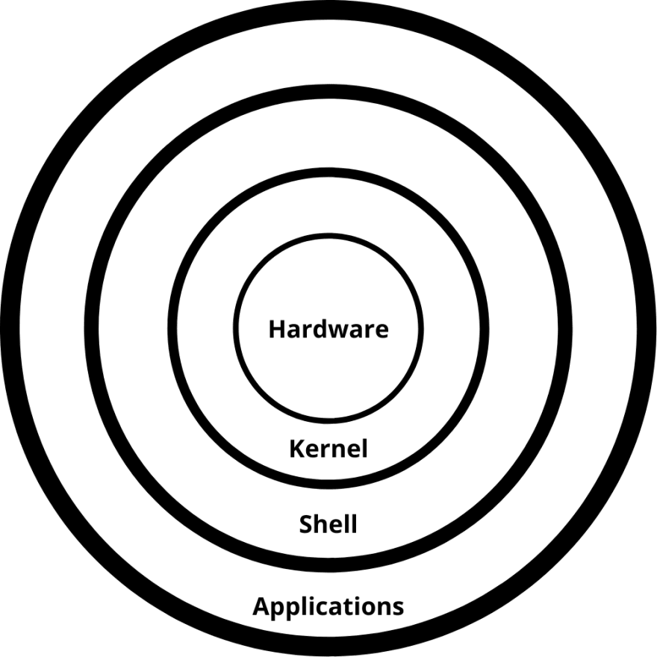
LAYERED STRUCTURE - UNIX

Slide 39
LAYERED STRUCTURE
ADVANTAGES
1. Easy Debugging
It is very simple to debug because the layers are discrete. If an error happens in the CPU scheduling layer, the developer may only debug that layer.
2. Modularity
This design supports modularity because each layer only executes tasks it is scheduled to perform.
3. Abstraction
Each layer is concerned with its own set of functions. As a result, the functions and implementations of the other layer are abstract to it.
4. Easy update
A modification in one layer does not affect the other layers.

Slide 40
LAYERED STRUCTURE
DISADVANTAGES
1. Complex and better implementation
Layer layout is important because a layer can utilize the services of the layers below it. For example, the backup storage layer uses the memory management layer's services, so it must be stored beneath the memory management layer.
2. Slower in execution
When one layer wishes to interact with another, it sends a request that must traverse all layers between the two layers to be fulfilled. It enhances response time, which is faster than the Monolithic system. As a result, increasing the number of layers may lead to a very inefficient design.

Slide 41
MICRO KERNEL ARCHITECTURE
Since the kernel is the core part of the operating system, so it is meant for handling the most important services only. Thus in this architecture, only the most important services are inside the kernel and the rest of the OS services are present inside the system application program. Thus users are able to interact with those not-so-important services within the system application. And the microkernel is solely responsible for the most important services of the operating system they are named as follows:
Inter process-Communication
Memory Management
CPU-Scheduling

Slide 42
MICROKERNEL ARCHITECTURE
Advantages of Microkernel
Modularity: Because the kernel and servers can be developed and maintained independently, the microkernel design allows for greater modularity. This can make adding and removing features and services from the system easier.
Fault isolation: The microkernel design aids in the isolation of faults and their prevention from affecting the entire system. If a server or other component fails, it can be restarted or replaced without causing any disruptions to the rest of the system.

Slide 43
MICROKERNEL ARCHITECTURE
Advantages of Microkernel
Performance: Because the kernel only contains the essential functions required to manage the system, the microkernel design can improve performance. This can make the system faster and more efficient.
Security: The microkernel design can improve security by reducing the system’s attack surface by limiting the functions provided by the kernel. Malicious software may find it more difficult to compromise the system as a result of this.

Slide 44
MICROKERNEL ARCHITECTURE
Advantages of Microkernel
Reliability: Microkernels are less complex than monolithic kernels, which can make them more reliable and less prone to crashes or other issues.
Scalability: Microkernels can be easily scaled to support different hardware architectures, making them more versatile.
Portability: Microkernels can be ported to different platforms with minimal effort, which makes them useful for embedded systems and other specialized applications.

Slide 45
05
RESOURCE MANAGEMENT

Slide 46
06
SECURITY AND PROTECTION

Slide 47
07
VIRTUALIZATION

